Slide 1
U-Net: Convolutional Networks
for
Biomedical Image Segmentation

Slide 2
Topics
Introduction
Motivation
U-NET architecture
U-NET Training
Data Augmentation
Experiments
Extending U-NET
Conclusion

Slide 3
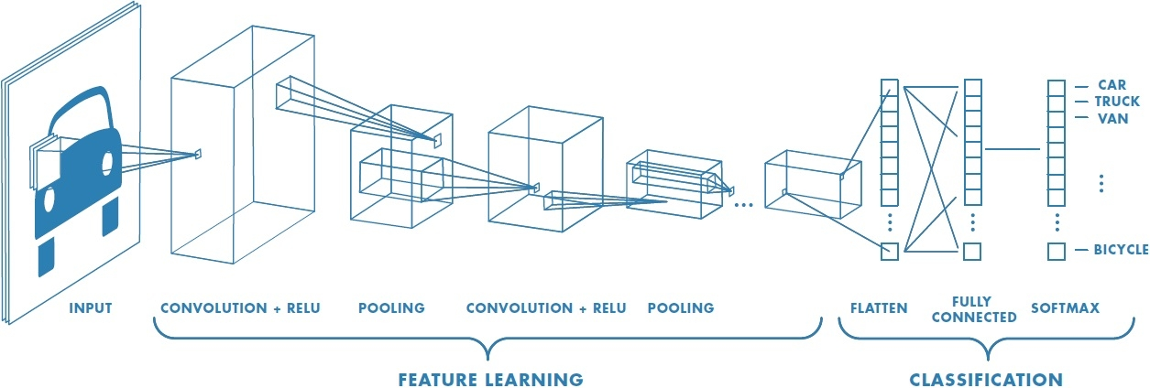
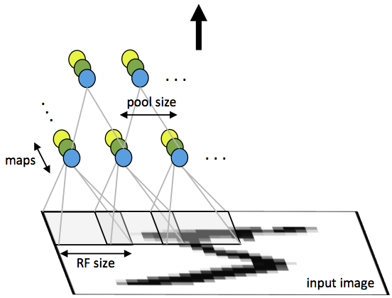
Introduction
Convolutional Neural Networks (CNN)
Convolutional networks make the assumption of locality, and hence are more powerful
The fewer number of connections and weights make convolutional layers relatively cheap (vs full connect) in terms of memory and compute power needed.

Slide 4
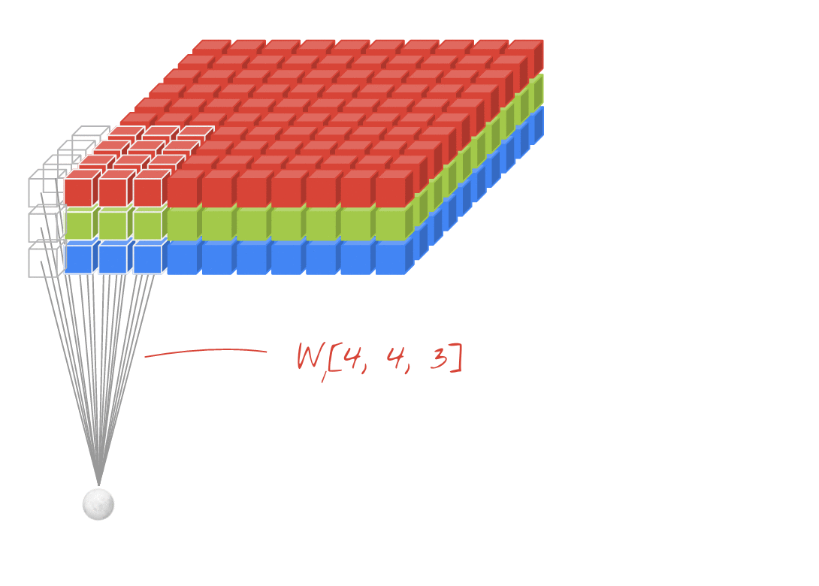
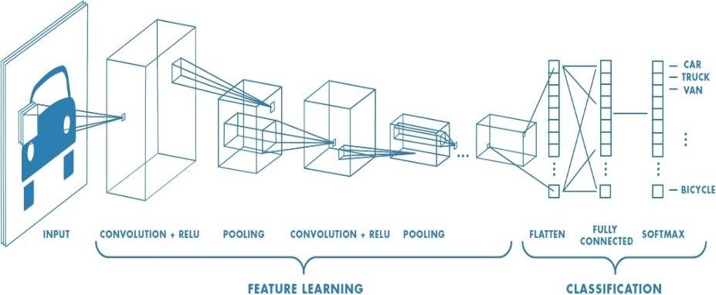
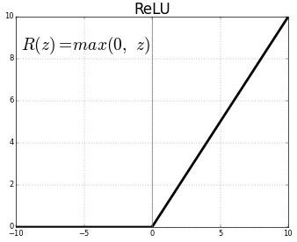
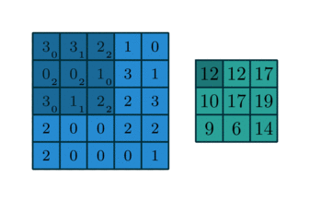
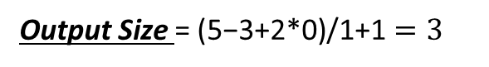
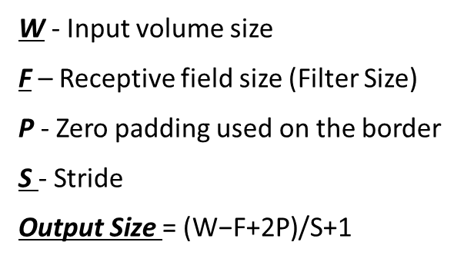
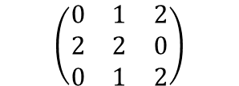
Introduction
Convolution Layer
Padding = 0
Strides = 1
W - Input volume size
F – Receptive field size (Filter Size)
P - Zero padding used on the border
S - Stride
Output Size $\text{=} \text{(}\text{W}\text{−}\text{F}\text{+2}\text{P}\text{)/}\text{S}\text{+1}$
Output Size $\text{=} \text{(}\text{5}\text{−}\text{3}\text{+2}\text{∗0}\text{)/}\text{1}\text{+1}=3$
kernel
$$\left(\begin{matrix}0 & 1 & 2 \\ 2 & 2 & 0 \\ 0 & 1 & 2\end{matrix}\right)$$

Slide 5
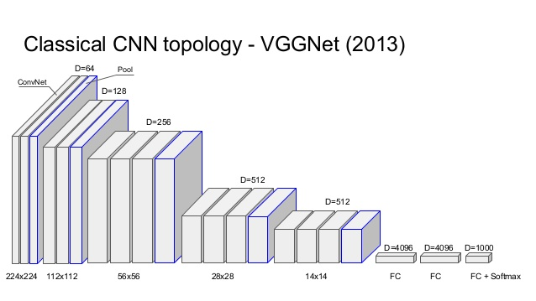
Introduction
The use of convolutional networks is on classification tasks where the output to typical image is a single class label.
In many visual tasks, especially in biomedical image processing, the desired output should include localization
A class label is supposed to be assigned to each pixel.

Slide 6
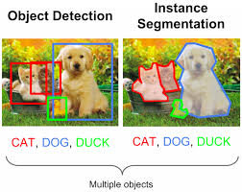
Background
Image segmentation:
Partitioning image into multiple segments
Locate objects and boundaries
Change image representation
Simplify for analysis
Semantic pixel-wise segmentation
Assign label to each pixel in the digital image

Slide 7
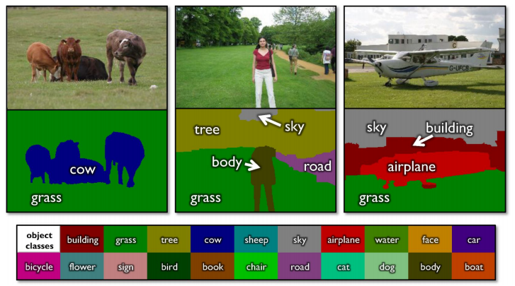
Introduction
Pixel-wise Semantic Segmentation
Label every pixel!
Don’t differentiate instances
Classic computer vision problem

Slide 8
Main Motivation
Biomedical Image Segmentation with U-net
Thousands of training images are usually beyond reach
in biomedical task
For example AlexNet:
8 layers and millions of parameters on on the ImageNet dataset
1 million training images
The desired output should include localization

Slide 9
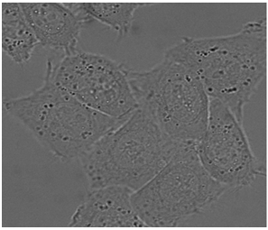
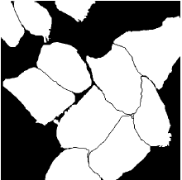
Main Motivation
Biomedical Image Segmentation with U-net
U-Net
Input image
Output segmentation map
U-net learns segmentation in and end-to-end setting
Touching objects of the same class
Vary few annotated images (approx. 30 per application)
Notes:
In the last layer there are 2 channels (1 for background and one for foreground)

Slide 10
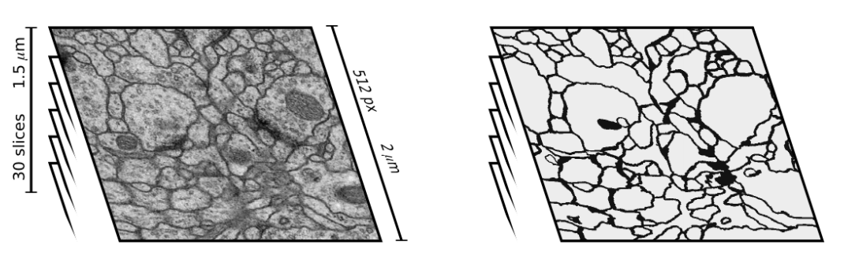
First Task
Predict the class label of each pixel
Stacks of Electron microscopy (EM) images
EM segmentation challenge at ISBI 2012
30 training images
Black - neuron membranes
White - cells
Training stack
Ground truth
Notes:
Left: the training stack (one slice shown). Right: corresponding ground truth; black lines denote neuron membranes. Note complexity of image appearance.

Slide 11
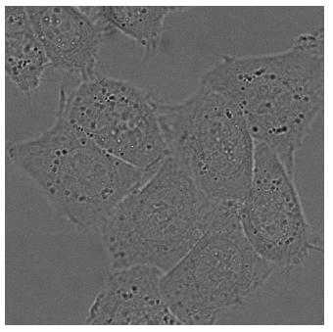
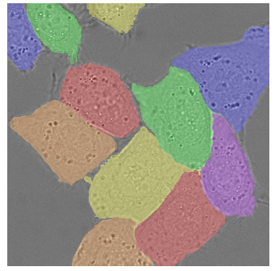
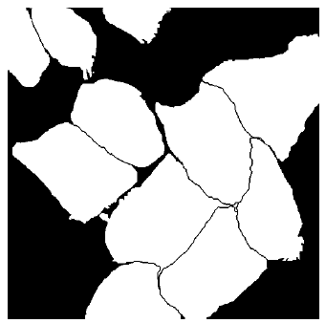
Second Task
ISBI 2015- separation of touching objects of the same class
Light microscopic images (recorded by phase contrast microscopy)
Part of the ISBI cell tracking challenge 2014 and 2015
Raw image (HeLa cells)
Generated segmentation mask
(white:foreground, black:background)
Ground truth segmentation.
Notes:
Fig. 3. HeLa cells on glass recorded with DIC (dierential interference contrast) mi-
croscopy. (a) raw image. (b) overlay with ground truth segmentation. Dierent colors
indicate dierent instances of the HeLa cells. (c) generated segmentation mask (white:
foreground, black: background). (d) map with a pixel-wise loss weight to force the
network to learn the border pixels.

Slide 12
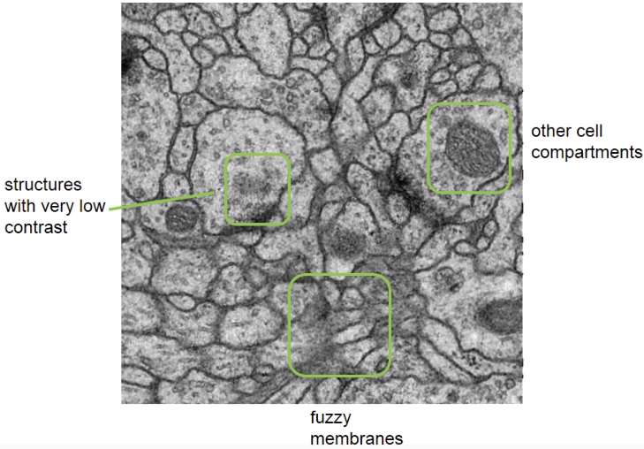
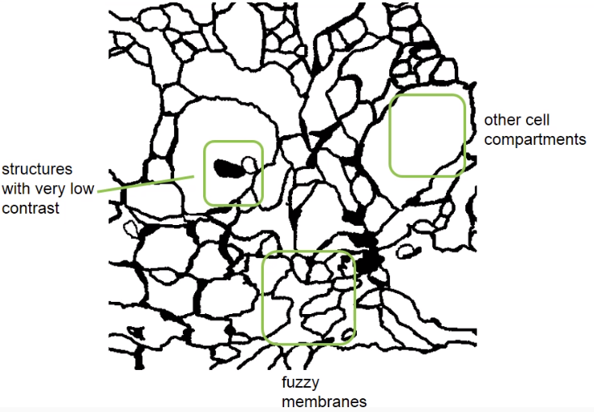
Challenges
Segmentation of Neuronal Structures in EM
Notes:
Fig. 3. HeLa cells on glass recorded with DIC (dierential interference contrast) mi-
croscopy. (a) raw image. (b) overlay with ground truth segmentation. Dierent colors
indicate dierent instances of the HeLa cells. (c) generated segmentation mask (white:
foreground, black: background). (d) map with a pixel-wise loss weight to force the
network to learn the border pixels.

Slide 13
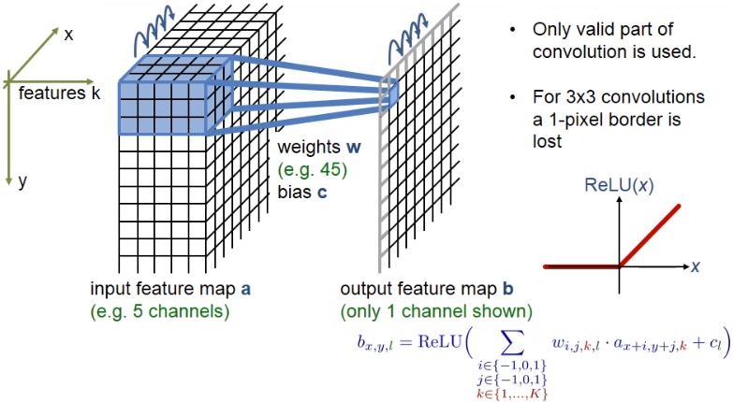
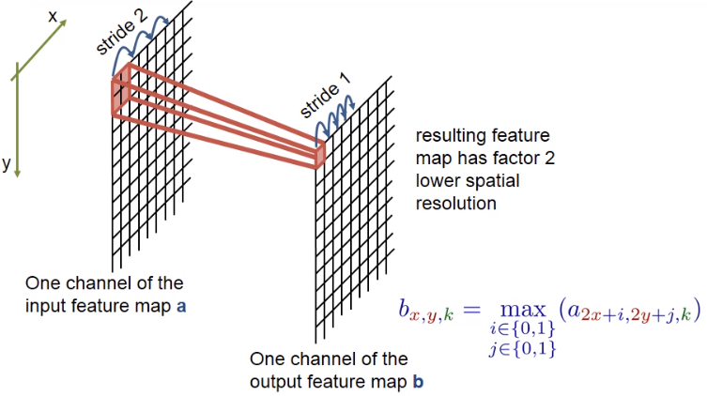
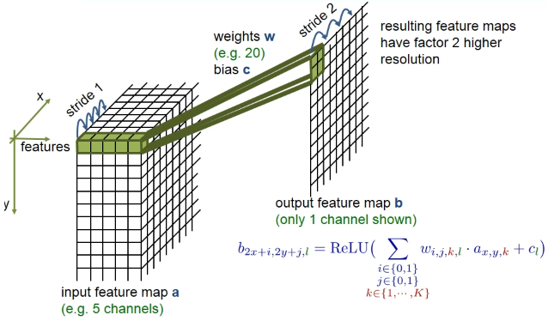
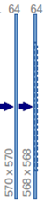
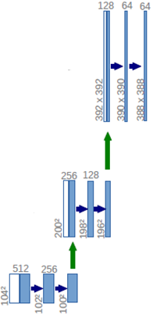
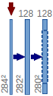
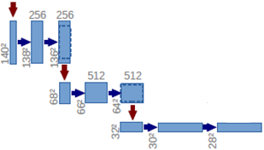
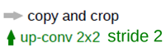
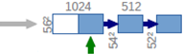
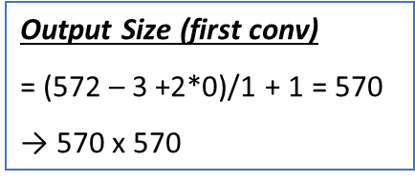
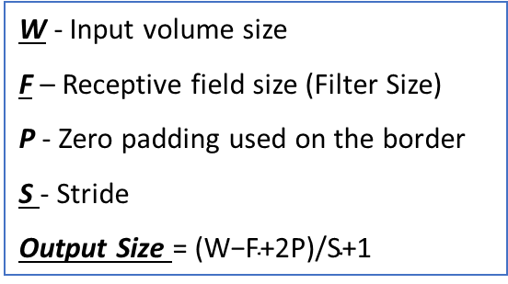
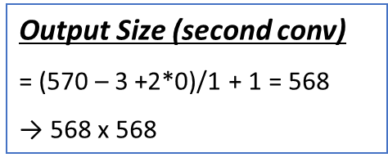
U-NET Architecture
Output
segmentation map
(here 2 classes)
background and
foreground
Input
image
tile
Concatenation with
high-resolution features
from contracting path
Output Size (second conv)
= (570 – 3 +2*0)/1 + 1 = 568
→ 568 x 568
Create high-resolution
segmentation map
Contraction
Expansion
Increase the “What”
Reduce the “Where”
W - Input volume size
F – Receptive field size (Filter Size)
P - Zero padding used on the border
S - Stride
Output Size $\text{=} \text{(}\text{W}\text{−}\text{F}\text{+2}\text{P}\text{)/}\text{S}\text{+1}$
Output Size (first conv)
= (572 – 3 +2*0)/1 + 1 = 570
→ 570 x 570
Notes:
In the last layer there are 2 channels (1 for background and one for foreground)

Slide 14
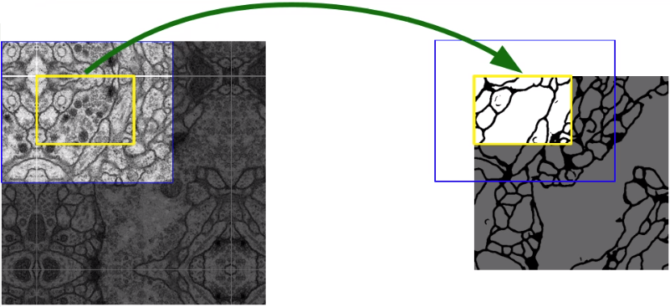
U-NET Strategy
Over-tile strategy for arbitrary large images
Segmentation of the yellow area uses input data of the blue area
Raw data extrapolation by mirroring
Notes:
In the last layer there are 2 channels (1 for background and one for foreground)

Slide 15
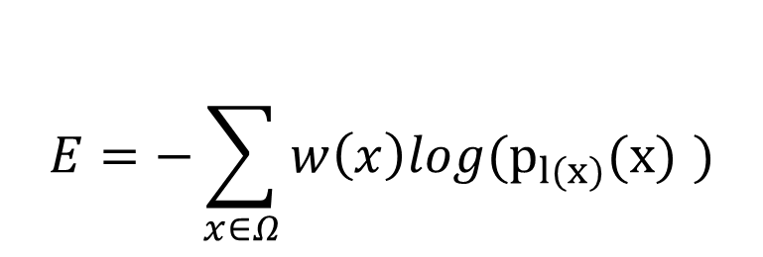

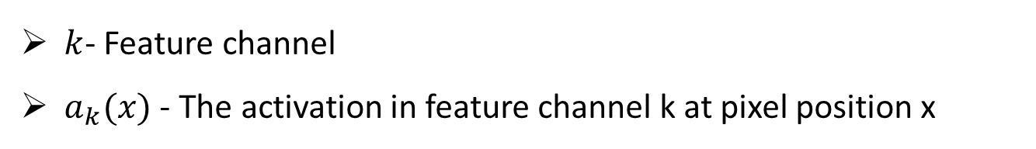
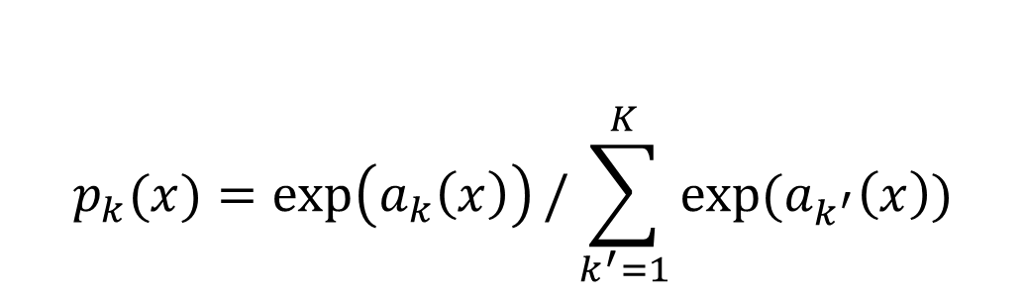
U-net Training
$$p_{k}(x)=\exp\left(a_{k}\left(x\right)\right)/\sum_{k^{′}=1}^{K}{exp⁡(a_{k^{′}}\left(x\right))}$$
Soft-max:
$k$- Feature channel
$a_{k}(x)$ - The activation in feature channel k at pixel position x
$$E=−\sum_{x∈Ω}{w\left(x\right)log(p_{l(x)}(x) )}$$
Cross-Entropy loss function:
$w(x)$- True label per a pixel

Slide 16
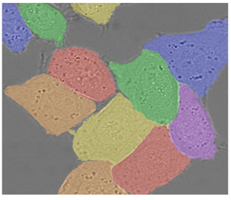
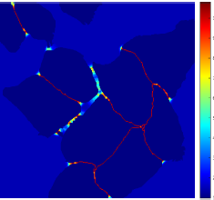
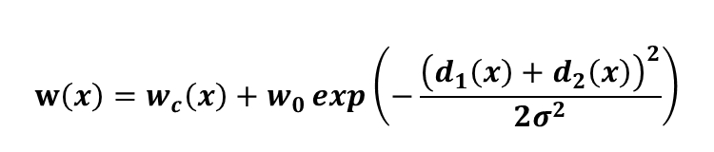
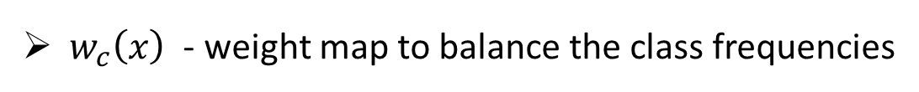
U-net Training
pixel-wise loss weight
Force the network to learn the small separation borders that they introduce between touching cells.
$$w\left(x\right)=w_{c}\left(x\right)+w_{0}\exp\left(−\frac{{\left(d_{1}\left(x\right)+d_{2}\left(x\right)\right)}^{2}}{2σ^{2}}\right)$$
Colors :different instances
$w_{c}\left(x\right)$ - weight map to balance the class frequencies
$d_{1}/d_{2}$- Distance to the border of the nearest cell / second nearest cell
$w_{0}$ - 10 , $σ≈5$ pixels

Slide 17
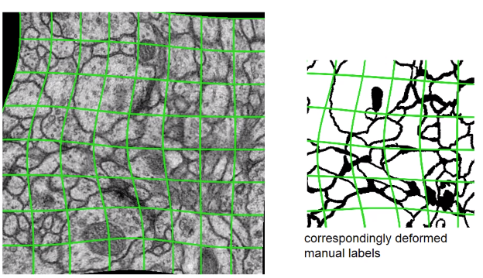
Data Augmentation
Augment Training Data using Deformation
Random elastic deformation of the training samples.
Shift and rotation invariance of the training samples.
They use random displacement vectors on 3 by 3 grid.
The displacement are sampled from Gaussian distribution with standard deviation of 10 pixels
Notes:
In the last layer there are 2 channels (1 for background and one for foreground)

Slide 18
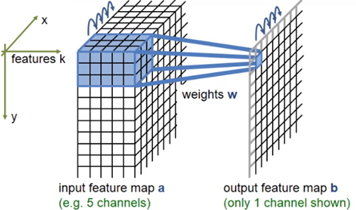
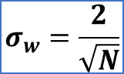
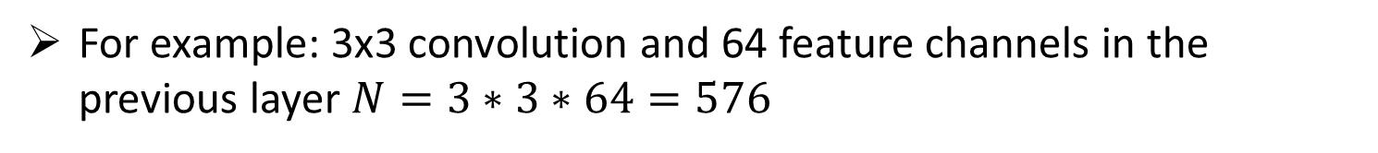
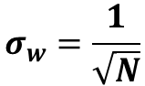
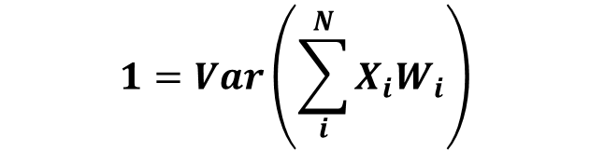
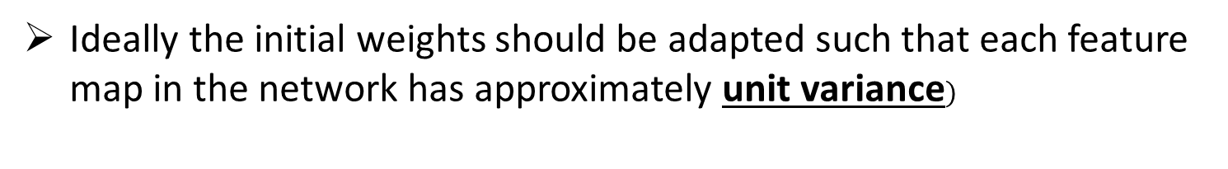
U-net Training
Weights initialization
A good initialization of the weights is extremely important
Ideally the initial weights should be adapted such that each feature map in the network has approximately unit variance$)$
$$1=Var\left(\sum_{i}^{N}{X_{i}W_{i}}\right)$$
Achieved by Gaussian distribution:
$$σ_{w}=\frac{1}{\sqrt{N}}$$
ReLU layers
$$σ_{w}=\frac{2}{\sqrt{N}}$$
ReLU unit is zero for non positive inputs
For example: 3x3 convolution and 64 feature channels in the previous layer $N=3∗3∗64=576$
Notes:
Example: if 3*3 convolution and 64 feature channels in the previous layer
then N = 9.64=576

Slide 19
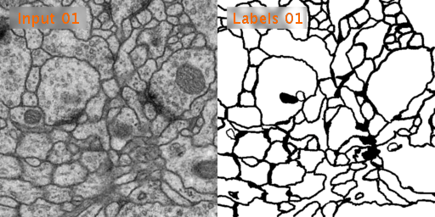
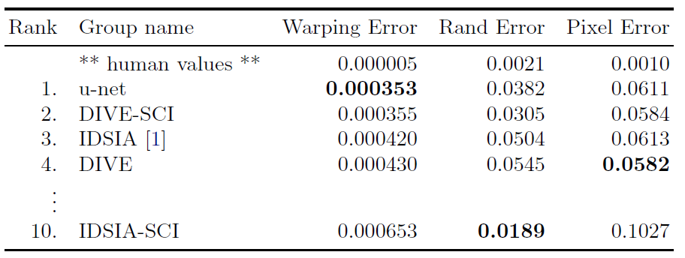
Experiments: First task
EM segmentation challenge (since ISBI 2012)
Raw image
Ground truth
The results of u-net is better than the sliding window convolutional network which was the best one in 2012 until 2015.

Slide 20
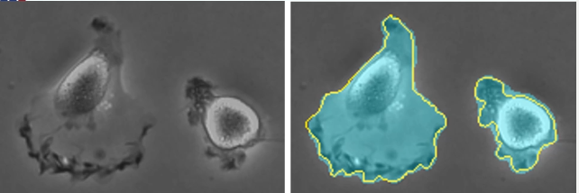




Experiments :Second/Third task
ISBI cell tracking challenge 2015
PhC-U373
DIC-Hela
Strong shape variations
Weak outer borders, strong irrelevant inner borders
Cytoplasm has same structure like background

Slide 21


Extending U-NET Architecture
Application scenarios for volumetric segmentation with the 3D u-net
Semi-automated segmentation
The user annotates some slices of each volume to be segmented
The network predicts the dense segmentation
Fully automated segmentation
Trained with annotated slices
Run on non-annotated volumes

Slide 22

Extending U-NET Architecture
Application scenarios for volumetric segmentation with the 3D u-net
Voxel size of 1.76×1.76×2.04µm3
Batch normalization (“BN”) before each ReLU
3 × 3 × 3 convolutions, 2 × 2 × 2 max pooling, upconvolution of 2 × 2 × 2
Output: 44×44×28 voxel
Input: 132 × 132 × 116 voxel tile
Jun 2016

Slide 23




Extends the previous u-net
Unsupervised Pre-training for Fully Convolutional Neural Networks
Additional reconstruction layer
LS is the softmax loss (standard cross entropy loss averaged over all pixels),
LR is the reconstruction loss (standard mean squared error)
shifted sigmoid
K = 50 was found to be sufficient
to ensure pre-training convergence
(2016)

Slide 24
Summary and Conclusion
U-net advantages
Flexible and can be used for any rational image masking task
High accuracy (given proper training, dataset, and training time)
Doesn’t contain any fully connected layers
Faster than the sliding-window (1-sec per image)
Proven to be very powerful segmentation tool in scenarios with limited data
Succeeds to achieve very good performances on different biomedical segmentation applications.
U-net disadvantages
Larger images need high GPU memory.
Takes significant amount of time to train (relatively many layers)
Pre-trained models not widely available (it's too task specific)
Notes:
https://spark-in.me/post/unet-adventures-part-one-getting-acquainted-with-unet

Slide 25
References
U-Net: Convolutional Networks for Biomedical Image Segmentation
Olaf Ronneberger, Philipp Fischer, and Thomas Brox
University of Freiburg, Germany
https://slideplayer.com/slide/14906132/

Slide 26
END
Thank You!
Notes:
https://spark-in.me/post/unet-adventures-part-one-getting-acquainted-with-unet

